Slide 1
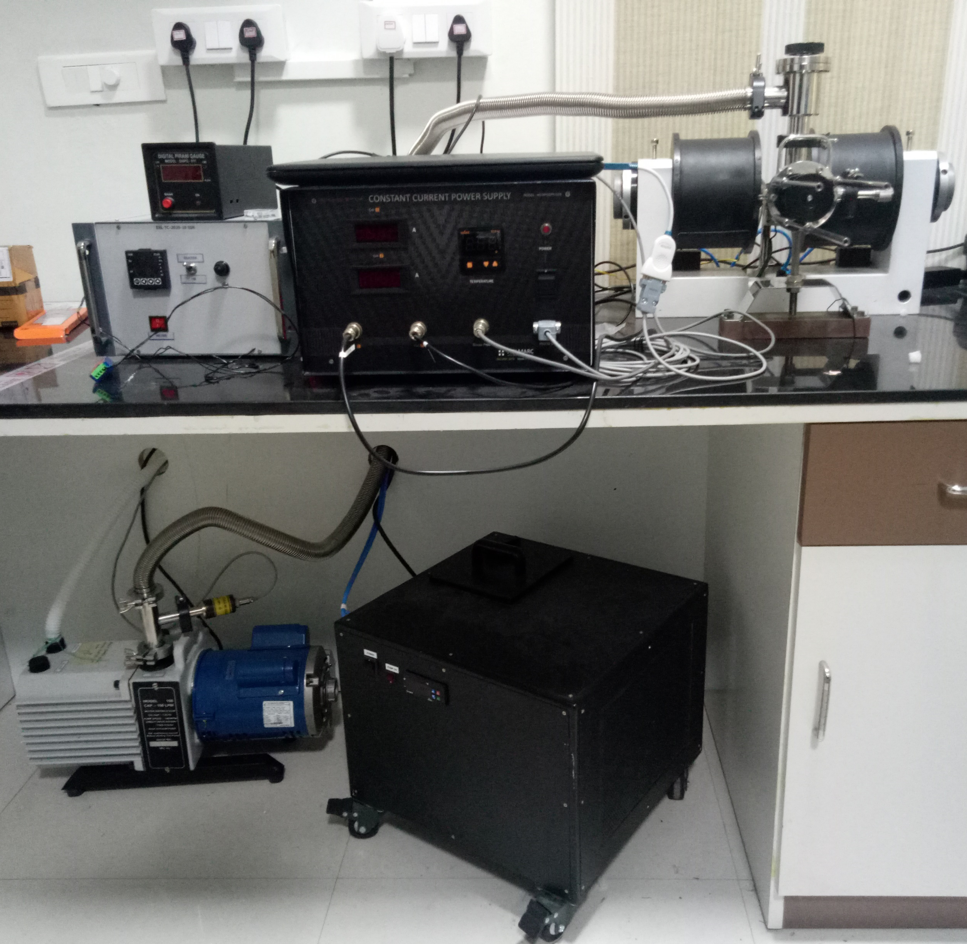
Pirani gauge
Electromagnet
MTA setup
Heater
Vacuum pump
Chiller

